Slide 1
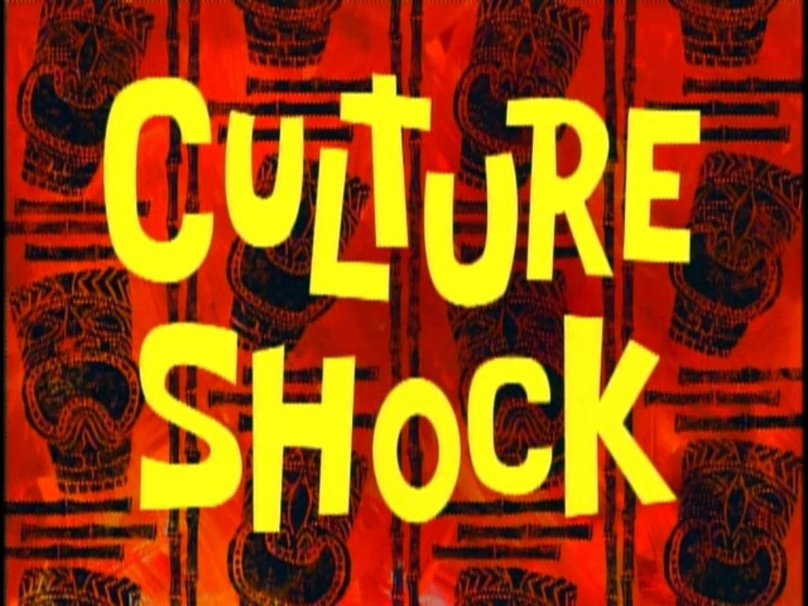

Unit 4

Slide 2
Term Explanation
Culture shock
Commonly experienced by travelers, expatriates and exchange students,“culture shock”describes the impacts of moving from a familiar culture to an unfamiliar culture.

Slide 3
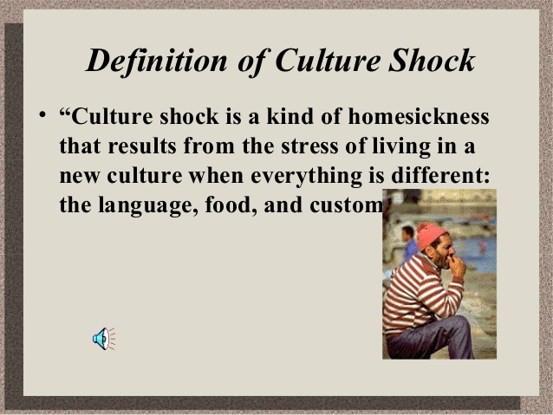

Slide 4
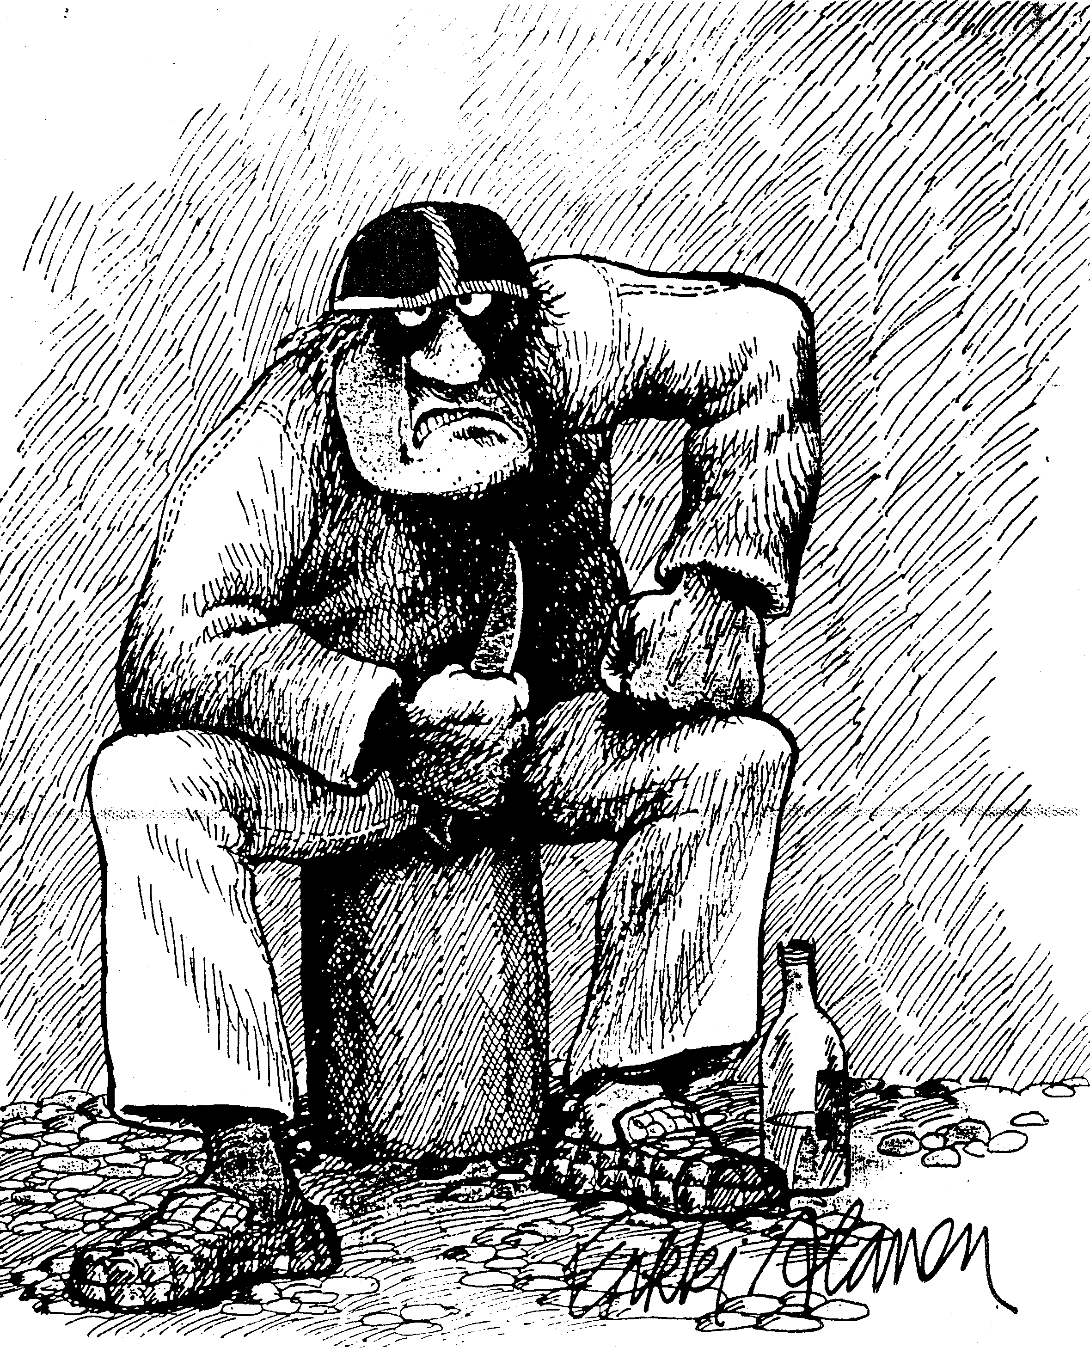
What is culture Shock?
“Cultural shock is caused by the anxiety resulting from losing all our familiar signs and symbols when we move to a new environment” (Oberg, 1958).
→ Lack of direction
Not knowing:
What to do?
How to do things?
When to do things?

Slide 5
深度阅读P58-60

Slide 6
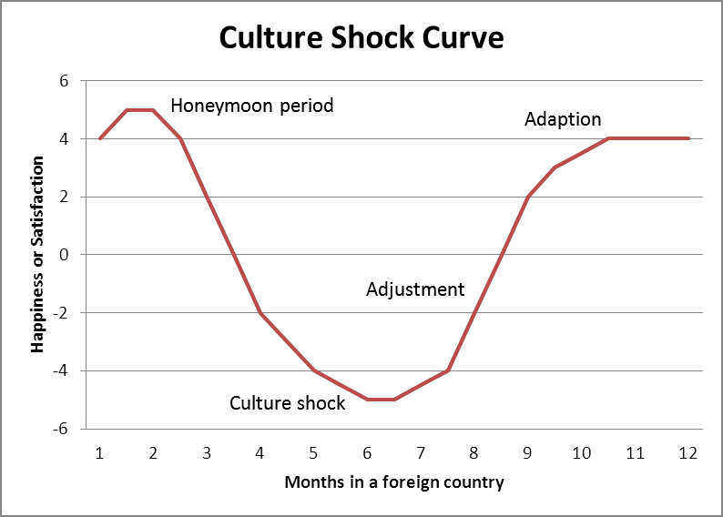

Slide 7
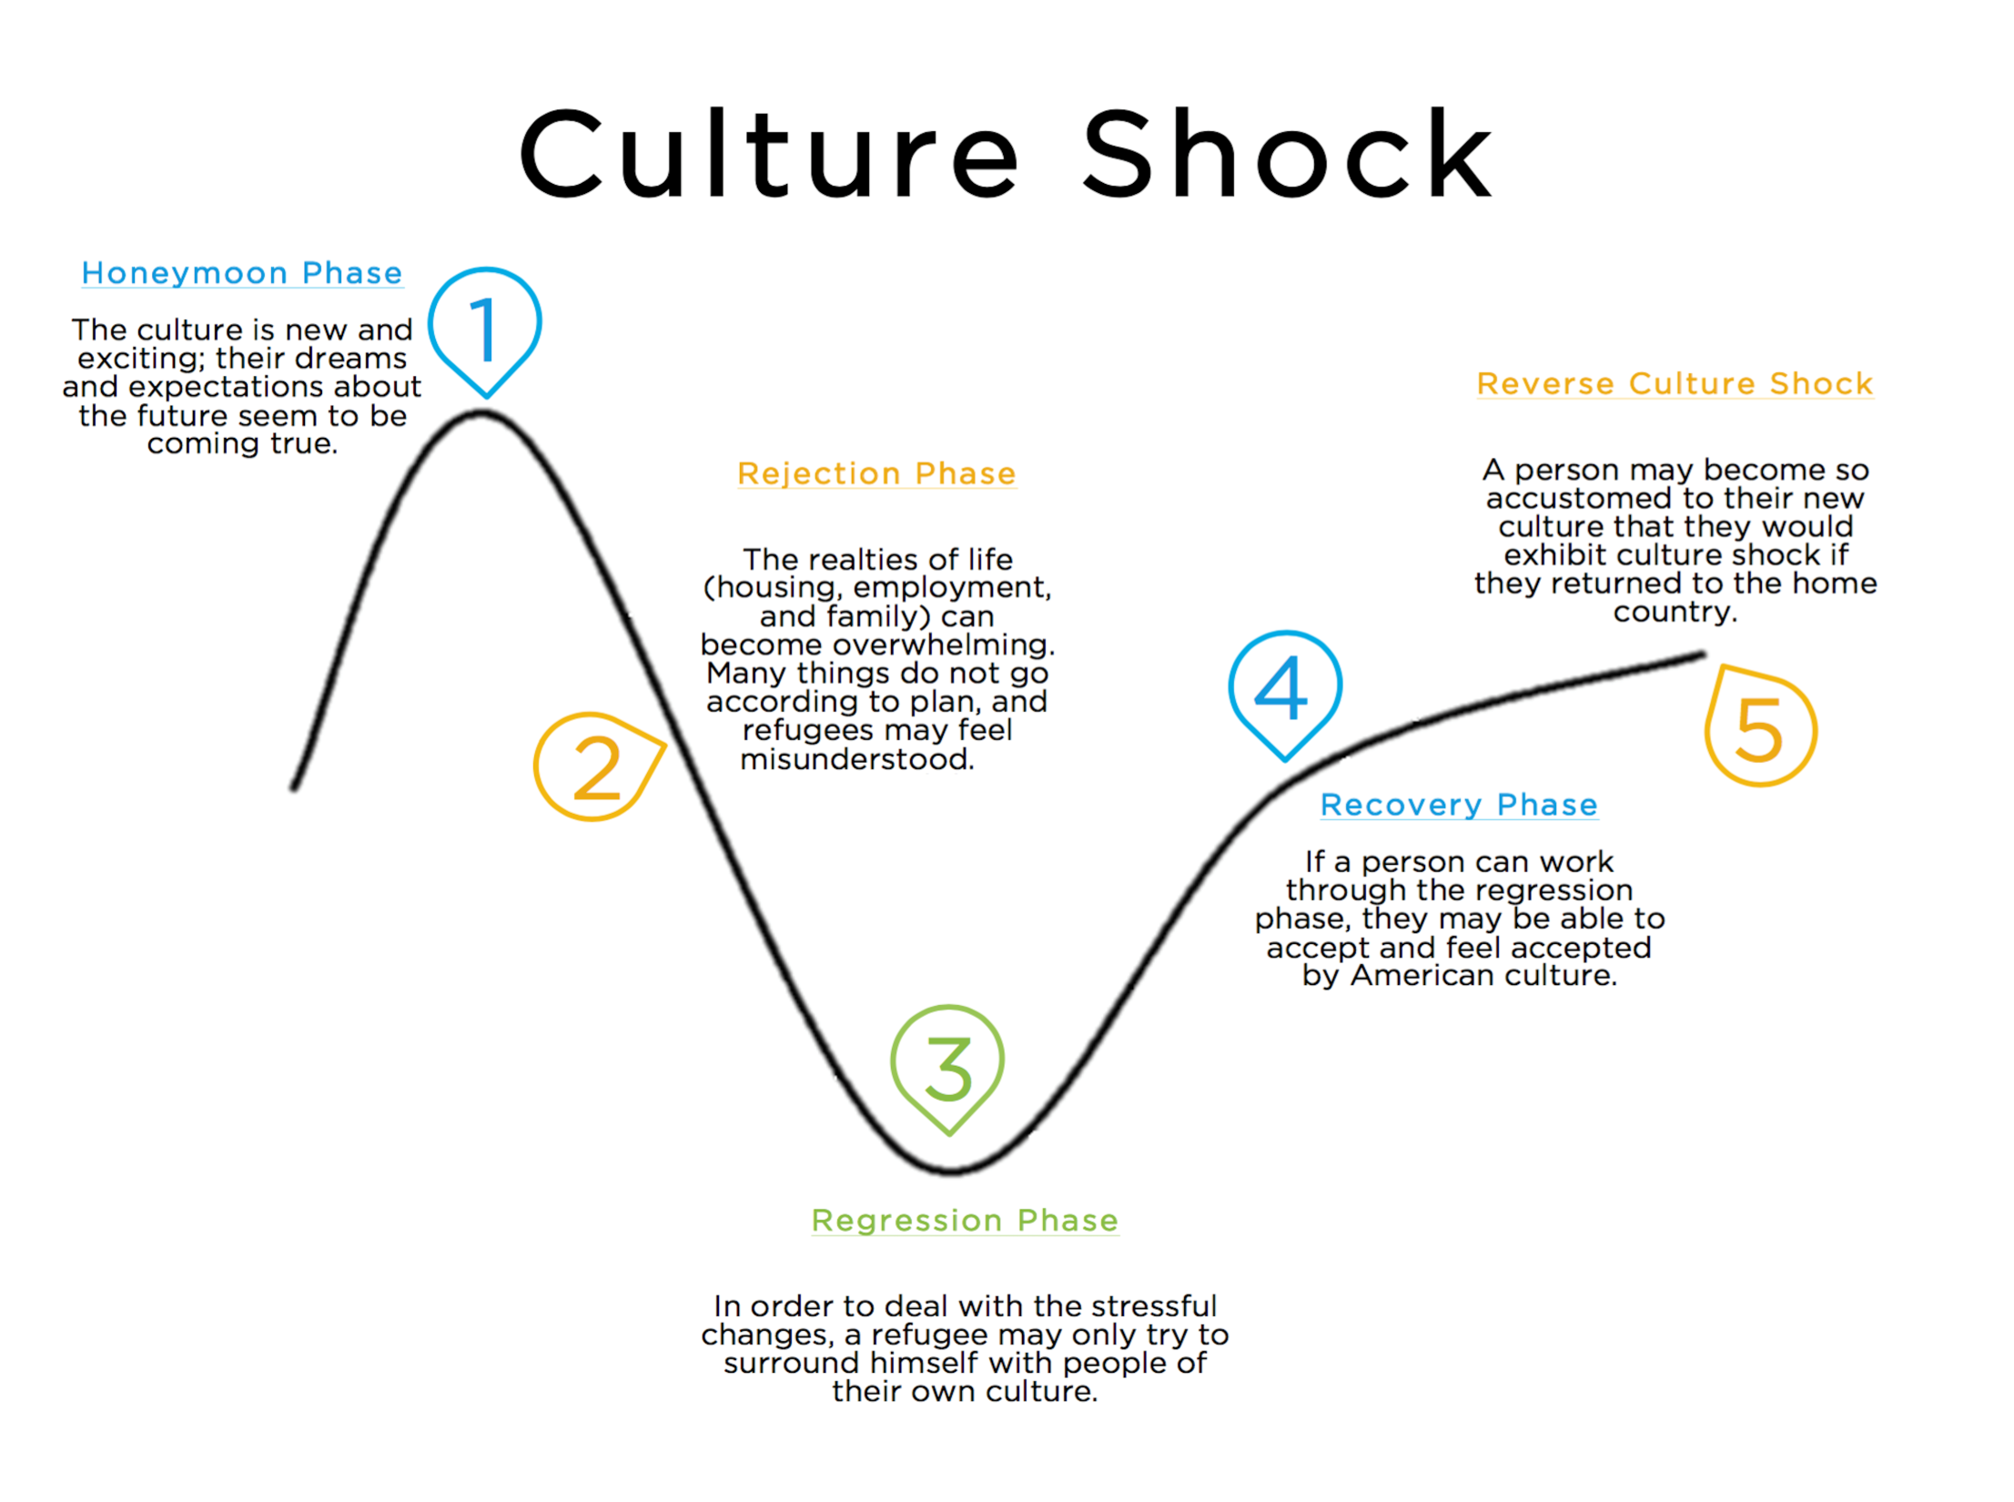

Slide 8
Phases of Culture Shock
① Honeymoon phase
The culture is new and exciting; their dreams and expectations about the future seem to be coming true.
② Rejection Phase
The realities of life (housing, employment, and family) can become overwhelming. Many things do not go according to plan, and they may feel misunderstood.

Slide 9
③ Regression Phase
In order to deal with the stressful changes, he/she may only try to surround himself with people of their own culture.
④ Recovery Phase
If a person can work through the regression phase, they may be able to accept and feel accepted by the new culture.
⑤ Reverse Culture Shock
A person may become so accustomed to their new culture that they would exhibit culture shock if they returned to the home country.

Slide 10
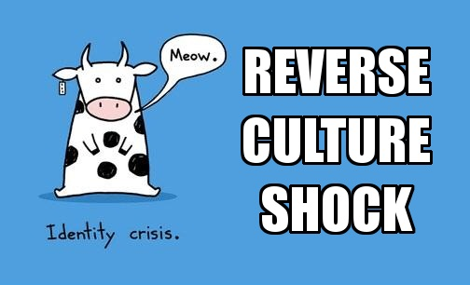

Slide 11
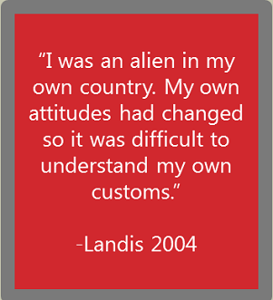

Slide 12
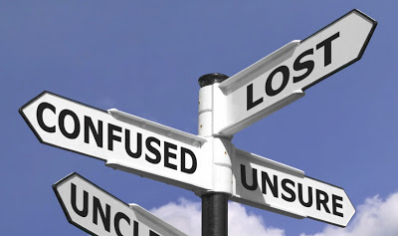

Slide 13


Slide 14
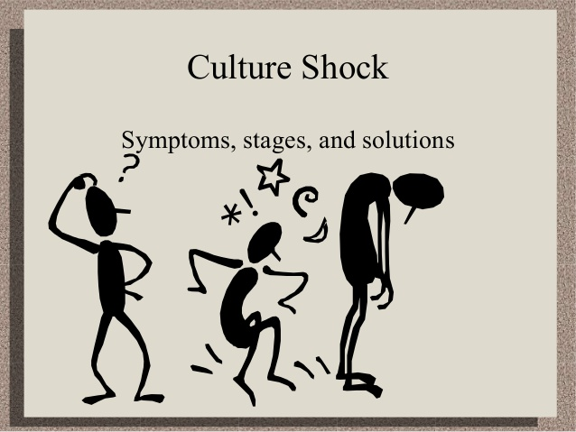

Slide 15
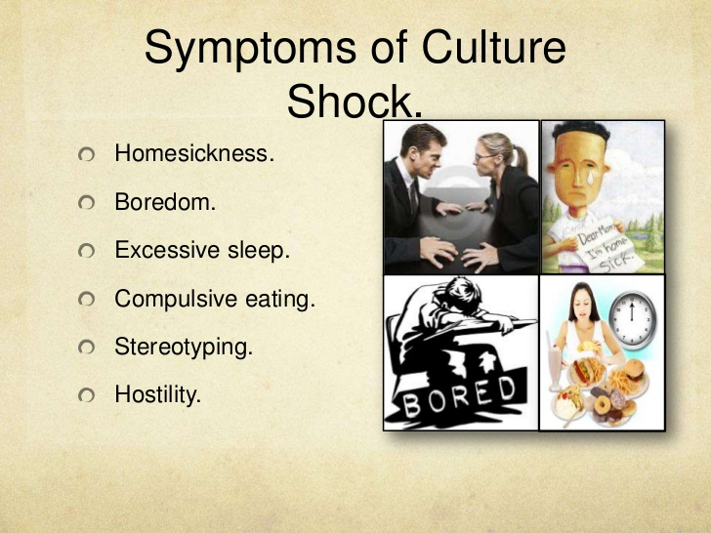

Slide 16
3. Symptoms of culture shock
Homesickness
Boredom
Withdrawal
Need for excessive amounts of sleep
Irritability
Exaggerated cleanliness
Compulsive eating and/or drinking
Marital stress, family tension and conflict
Chauvinistic excesses
Stereotyping of host nationals
Hostility toward host nationals
Loss of ability to work effectively
Unexplained fits of weeping

Slide 17
4. Causes of culture shock
① loss of control
② being deprived of familiar and loved things and people
③ physical, mental, and emotional fatigue
④ the sheer unfamiliarity of everything around them

Slide 18

Surviving among aliens: Managing Culture Shock
p59-

Slide 19
How to overcome culture shock in a foreign country
https://www.wikihow.com/Overcome-Culture-Shock-in-a-Foreign-Country

Slide 20
How to overcome culture shock in a foreign country
https://www.wikihow.com/Overcome-Culture-Shock-in-a-Foreign-Country
face value:(PHRASE) If you take something at face value, you accept it and believe it without thinking about it very much, even though it might untrue. (相信) 表面。

Slide 21
4. Do not take cultural familiarity or knowledge at face-value. Even as you become more savvy about rituals, customs and protocol in your new environment, be careful not to attribute an explanation or rationale to what you now believe you know. A little bit of knowledge can be misleading. Psychologist Geert Hofstede wrote that 'culture' is like an onion that can be peeled, layer by layer, to reveal the content. It takes a long time to really understand a culture in its social and historical context.

Slide 22
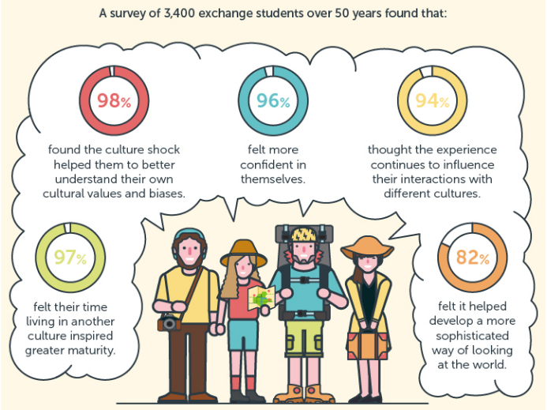

Slide 23
Case Study: P54-The Shopper
Usages (word combinations) p56-
For sure
Un/receptive toward
To practice with
To practice on
To get tired of
In the way
In a bad mood
To catch (someone) on a bad day

Slide 24
Practicing English
The worldwide popularity of English;
A feeling of being used if the person is more interested in practicing than actually communicating;
Interested in thinking of one’s own question rather than in listening to what the foreigner has to say;
Quite tiring/simply need a break from speaking English with students

Slide 25
Symptoms of culture shock
Homesickness
Boredom
Withdrawal
Need for excessive amount of sleep
Compulsive eating and/ or drinking
Irritability
Exaggerated cleaniness
Marital stress, family tension and conflict
Chauvinistic excesses

Slide 26

Definition
High-context culture
Low-context culture

Slide 27
High-Context
A high-context communication is one in which most of the information is either in the physical context or internalized（内在化的） in the person while very little is in the coded, explicit, transmitted part of the message. 高语境文化传播的绝大部分信息或存于物质语境中，或内化在个人身上，而极少数则处在清晰，被传递的编码讯息中。

Slide 28
In high-context cultures such as those of Japan, Korea, and China, people tend to be more aware of their surroundings and their environment and do not rely on verbal communication as their main information source. The context of the message is well understood by both sender and receiver. In high-context cultures reading between the lines（言外之意） in order to understand the intended meaning of the message is needed.

Slide 29
Low-context
Low-context communication is just the opposite, the mass of the information is vested（既定的） in the explicit code, and the context or situation plays a minimal role..低语境文化中，信息的意义通过语言可以表达得很清楚，大量的信息置于清晰的编码中，不需要依赖环境去揣摩推测。

Slide 30
In a low-context language and culture, the message is ex­plicit; it may be given in more than one way to ensure understanding by the receiver. In low-context languages, a person would state what is expected or wanted.

Slide 31
That is to say...
High-context communication --most of a message is conveyed by the context surrounding it, not in explicit words
Low-Context communication -- emphasizes directness rather than relying on context

Slide 32

Countries of HC/LC
HC | LC
China | America
Japan | Germany
Korea | France
African America | Scandinavian

Slide 33


Context
Low-context
High-context

Slide 34
Pay attention in cross-cultural communication with...
...with people from low-context | ...with people from high-context
Provide detailed and direct information; Don't beat about the bush; For the primary purpose in solving problems. | Be carefull with the connotation; Make your advice politely and also take care of others' faces. For the primary purpose in common view.

Slide 35
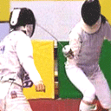
Conclusion
Cross-cultural communication
≠

Slide 36

We should...
In order to communicate each other well, the people from these two countries should strengthen communication to acknowledge each other well and avoid the misunderstandings in between due to the cultural disparities.

